Slide 1
Chapter 4

Slide 2
Objectives

Slide 3
Objectives (continued)

Slide 4
Testing vs. debugging

Slide 5
Four test phases

Slide 6
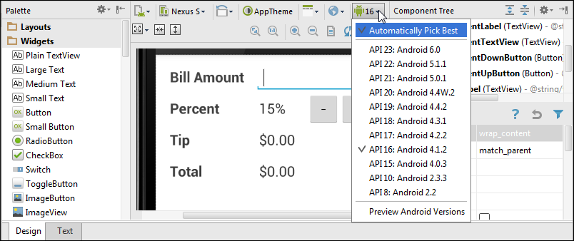
A layout in the graphical editor displayed by Android 4.1.2 (API 16)

Slide 7
How to check the layout

Slide 8
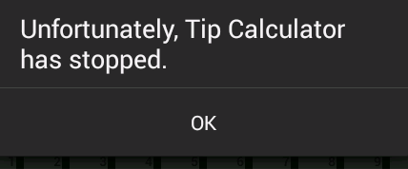
The error that’s displayed when an app crashes

Slide 9
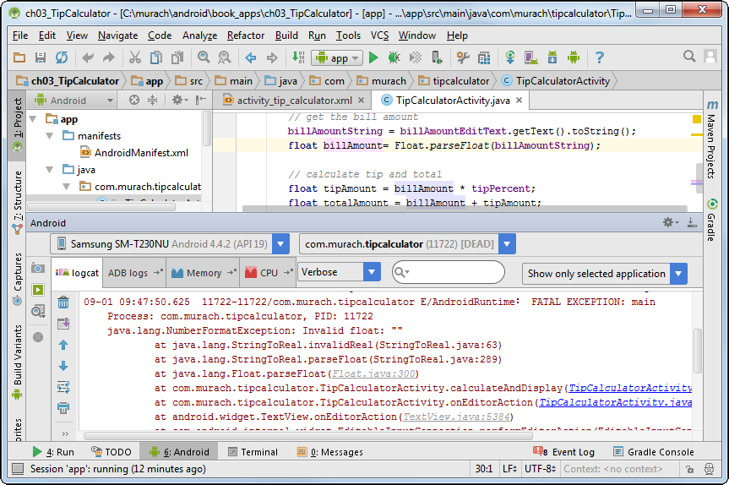
The LogCat view after a crash

Slide 10
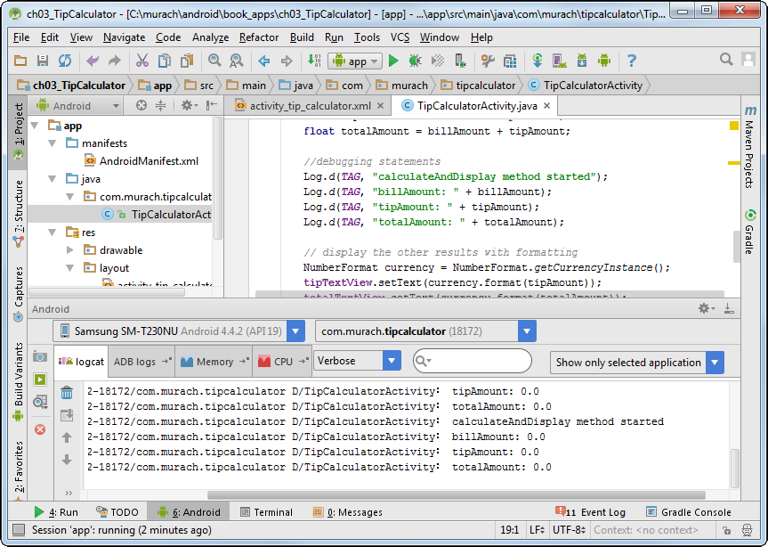
Android Studio with the LogCat window displayed

Slide 11
A few methods of the Log class

Slide 12
How to use the Log class to trace code execution

Slide 13
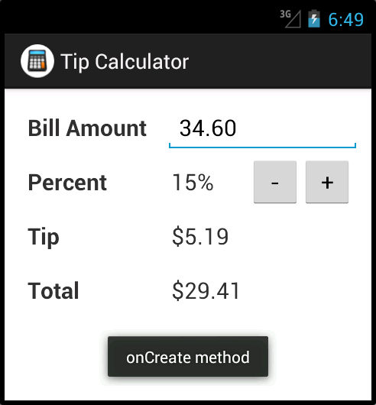
A toast displayed in an emulator

Slide 14
Two methods of the Toast class

Slide 15
How to display a toast

Slide 16
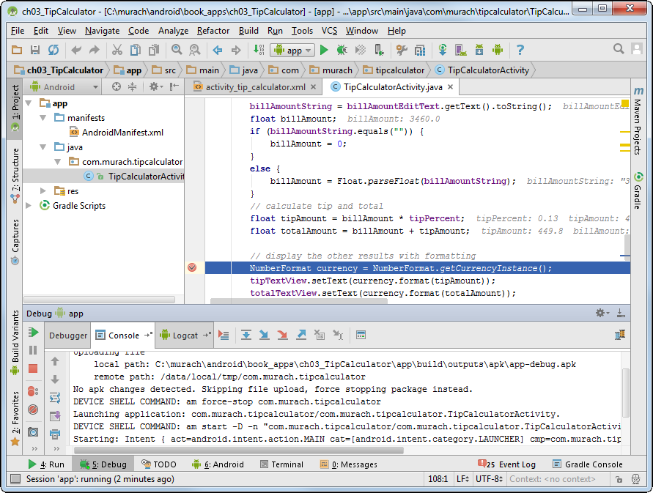
The Java code with a breakpoint

Slide 17
How to set and remove breakpoints

Slide 18
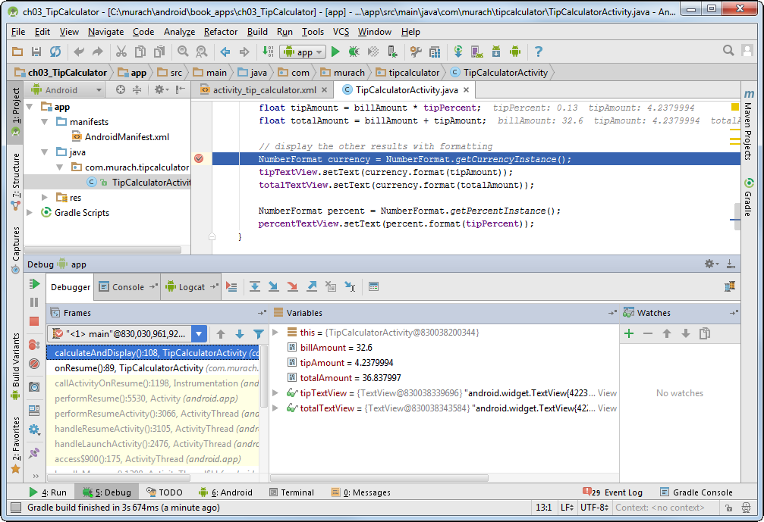
The Debug window

Slide 19
How to work with the Debug window

Slide 20
How to create an emulator

Slide 21
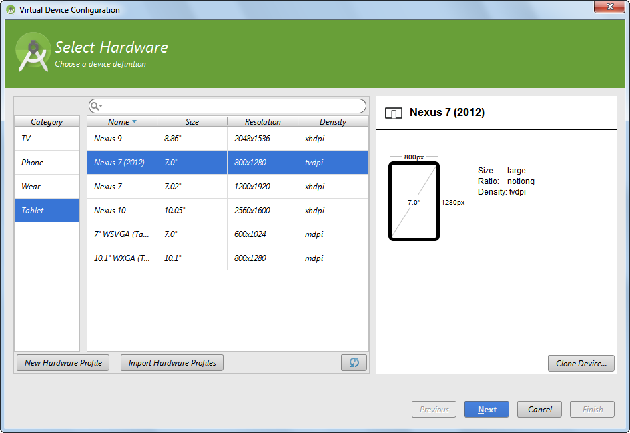
A built-in hardware profile for a tablet

Slide 22
How to create a new device definition

Slide 23
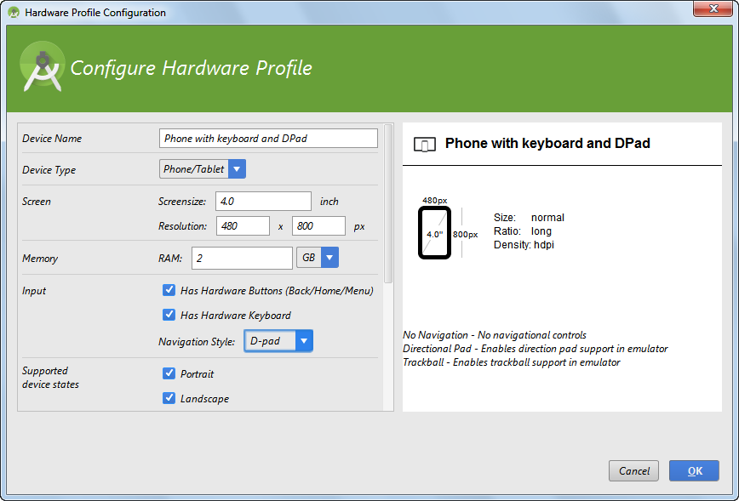
A new hardware profile for a phone with keyboard and DPad

Slide 24
An emulator for a tablet

